Slide 1

Green Pace
Security Policy Presentation
Developer: Michael Barbuzano

Slide 2

OVERVIEW: DEFENSE IN DEPTH
This security policy defines the core security principles, coding, authorization, authentication, auditing, and data encryption standards.

Slide 3
THREATS MATRIX
Likely STD-EXP63-CPP(Do not rely on the value of a moved-from object) STD-CON52-CPP(Prevent data races when accessing bit-fields from multiple threads) STD-POS49-C(When Data must be accessed by multiple threads, provide a mutex and guarantee no adjacent data is also accessed.) | Priority STD-DCL50-CPP(Do Not Define a C-style variadic function) STD-IDS00-J(Prevent SQL Injection) STD-ERR56-CPP(Guarantee exception safety) STD-MSC59-J(Limit the lifetime of sensitive data) STD-MEM50-CPP(Do not access freed memory)
Low priority STD-DCL03-C(Use a static assertion to test the value of a constant expression) | Unlikely STD-ERR62-CPP(Detect errors when converting a string to a number)

Slide 4
10 PRINCIPLES
Validate Input Data: (Prevent SQL Injection)
Heed Compiler Warnings: (Do Not Define a C-style variadic function, Do not rely on the value of a moved-from object, Detect errors when converting a string to a number, Prevent data races when accessing bit-fields from multiple threads, Use a static assertion to test the value of a constant expression)
Architect and Design for Security Policies:
Keep it Simple: (Do not rely on the value of a moved-from object, Guarantee exception safety, Do not access freed memory, When Data must be accessed by multiple threads, provide a mutex and guarantee no adjacent data is also accessed.)
Default Deny:
Adhere to the last Principle of Least Privilege:
Sanitize Data Sent to Other Systems: (Prevent SQL Injection, Limit the lifetime of sensitive data)
Practice Defense in Depth: (Limit the lifetime of sensitive data)
Use Effective Quality Assurance Techniques: (Detect errors when converting a string to a number, Prevent data races when accessing bit-fields from multiple threads, Use a static assertion to test the value of a constant expression, Guarantee exception safety, Limit the lifetime of sensitive data)
Adopt a Secure Coding Standard: (Prevent data races when accessing bit-fields from multiple threads)

Slide 5
CODING STANDARDS
STD-IDS00-J(Prevent SQL Injection)
STD-DCL03-C(Use a static assertion to test the value of a constant expression)
STD-POS49-C(When Data must be accessed by multiple threads, provide a mutex and guarantee no adjacent data is also accessed.)
STD-DCL50-CPP(Do Not Define a C-style variadic function)
STD-MEM50-CPP(Do not access freed memory)
STD-CON52-CPP(Prevent data races when accessing bit-fields from multiple threads)
STD-ERR56-CPP(Guarantee exception safety)
STD-MSC59-J(Limit the lifetime of sensitive data)
STD-ERR62-CPP(Detect errors when converting a string to a number)
STD-EXP63-CPP(Do not rely on the value of a moved-from object)

Slide 6
ENCRYPTION POLICIES
Encryption in rest: Encryption at rest refers to the encryption of data when it is stored in a database, file, system, or storage device. The policy mandates that all sensitive data stored in databases or storage must be encrypted using strong encryption algorithms.
Encryption at flight: The policy mandates the use of encryption protocols for all data transmitted over public or untrusted networks. It ensures data confidentiality during transmission and guards against eavesdropping and interception.
Encryption in use: The policy requires the use of encryption techniques such as secure memory handling, application-level encryption, and hardware security modules for sensitive data during processing.

Slide 7
TRIPLE-A POLICIES
Authentication: Authentication refers to the process of verifying the identity of users, systems, or entities attempting to access resources or systems. Authentication ensures that only authorized individuals can gain access, reducing the risk of data breaches.
Authorization: Authorization defines what actions and resources a user or system is allowed to access after successful authentication. Authorization policies help prevent unauthorized access and data misuse.
Accounting: Accounting, also known as auditing or logging, involves tracking and recording activities related to user logins, changes to the database, addition of new users, user access levels, and files accessed by users. Accounting assists in detecting and investigating security incidents, ensuring compliance, and providing a record of who accessed what and when.

Slide 8
Unit Testing
SQL Injection Unit Tests.

Slide 9
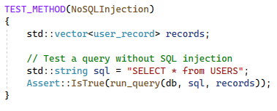
SQL Injection Test 1

Slide 10
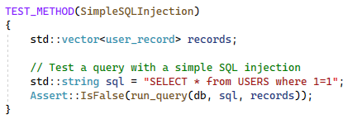
SQL Injection Test 2

Slide 11
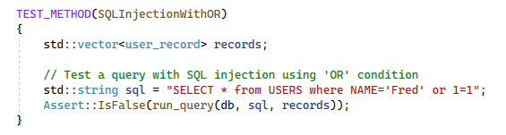
SQL Injection Test 3

Slide 12
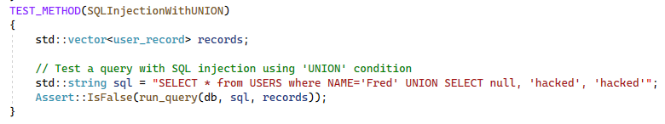
SQL Injection Test 4

Slide 13

AUTOMATION SUMMARY

Slide 14
TOOLS
The DevSecOps Pipeline is an extension of the traditional DevOps pipeline, with a stronger focus on integrating security practices throughout the software development lifecycle.
External tools play a crucial role in implementing security checks and controls at multiple stages of the DevSecOps pipeline.
Static code analysis tools such as CodeSonar, Coverity, Helix QAC, and Parasoft will be used throughout the development and testing processes to enforce secure coding practices.
Real-time monitoring tools such as Prometheus, Grafana, and New Relic will allow for real-time monitoring of applications and infrastructure.
Utilizing bots in messaging software such as Microsoft teams will allow for automation of real-time communication and incident triage.

Slide 15
RISKS AND BENEFITS
Waiting can lead to the exploitation of security vulnerabilities.
Deploying this policy now would lead to enhanced security, but the policy may have to be updated in the future to include more coding standards.

Slide 16
RECOMMENDATIONS
Iterative improvement may be necessary to attain an effective security policy.
This current policy only contains 10 coding standards, more should be added in the future to cover more coding principles and vulnerabilities.

Slide 17
CONCLUSIONS
Secure coding standards should be implemented and utilized, as malicious hacker techniques are innovated and developed.
Prioritize Data Security.

Slide 18
REFERENCES
Bellairs, R. (n.d.). Coding standards best practices: How to use coding standards. Perforce Software. https://www.perforce.com/blog/qac/coding-standards-best-practices-how-use-coding-standards
CISA, R. D. (PARTNER |. (2021, October 26). The importance of a company information security policy. Linford & Company LLP. https://linfordco.com/blog/information-security-policies/
Secure coding: A practical guide. Mend. (2023, August 17). https://www.mend.io/blog/secure-coding/

